Slide 1
All You Need to Know
About Glass

Slide 2
Glass Glass GLASS!!!!
Glass is made up of three things:
SAND (silicon dioxide) viscosity
SODA ASH (sodium carbonate) fluidity
LIME (calcium oxide) stability

Slide 3
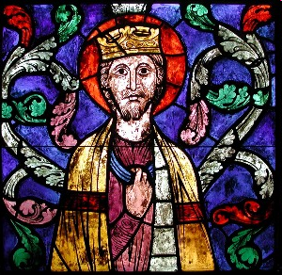
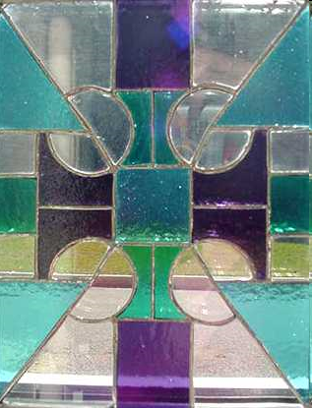
True Stained Glass vs. Today’s Stained Glass
*True Stained Glass is STAINED:
-Painted On, Then Fired
*Today’s Stained Glass is
-Colored in the manufacturing process with metal oxides

Slide 4
Metal Oxides
COBALT makes blue glass
SELENIUM makes red
GOLD makes pink
SULFUR-makes amber
COPPER- makes green
TIN or CALCIUM- makes white

Slide 5
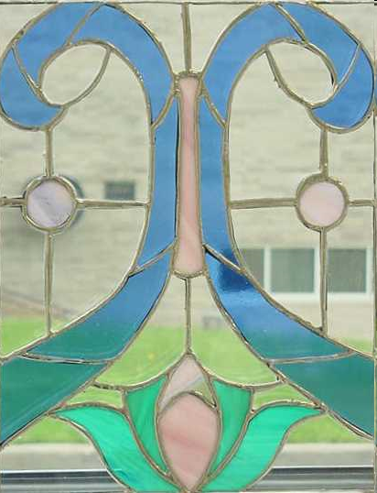
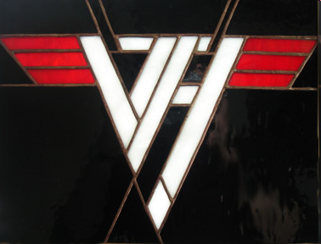
Qualities of Glass
Transparent- see through
Translucent- lets light through only
Opaque- cannot see through
(black glass)

Slide 6
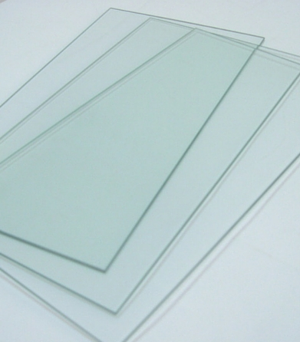
Clear Glass
Transparent
No color
Sometimes has a blue-green cast around the edges from
iron oxide

Slide 7





Cathedral Glass
Transparent
Colored
May have a texture

Slide 8
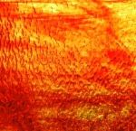
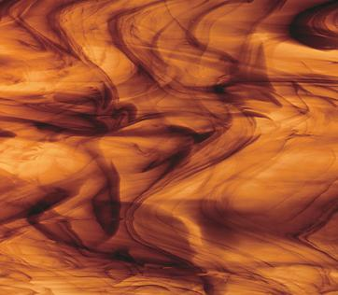
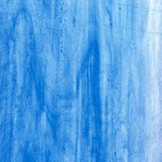


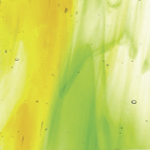
Streaky (or Wispy)
Usually transparent,
with another color of swirls in it.

Slide 9
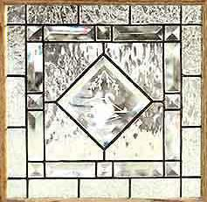

Glue Chip
Glass which has been
surface-treated
with glue, then fired.
The glue chips off, and then looks like
a frosted windshield

Slide 10
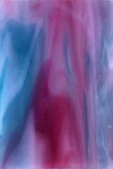
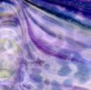




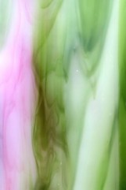
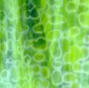
Opalescent Glass
Translucent glass
with two or more
colors swirled together

Slide 11




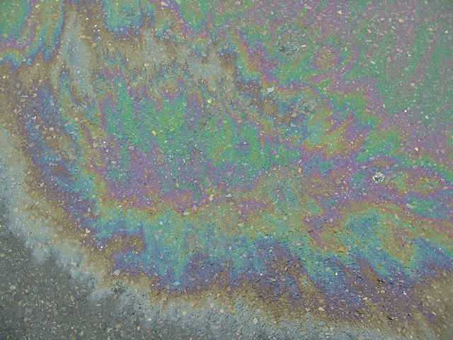
Iridescent Glass
Glass treated with a finish that makes its surface ‘shimmer’ with sparkles of
pink, green and gold
(looks like an oil spill)

Slide 12




Baroque (not broke..) Glass
Clear glass with
bold swirls
of one or two colors

Slide 13
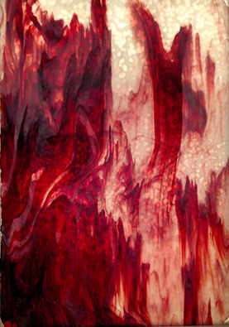
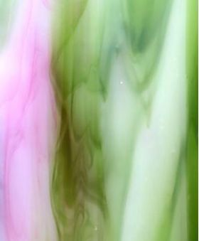
Off Limits to Beginners
Intermediate and Advanced Students Only:
        “Specialty Glass”
        *Baroque
        *Certain Opalescents

Slide 14
Glass…not cheap…...
Warm Colored Glass-
Red Yellow and Orange & Pink
IS DOUBLE
THE PRICE OF
Cool-Colored Glass-
Blue Green and Purple

Slide 15
Glass…not cheap…...
You may purchase warm colors from me
or from Hobby Lobby.
If you just need a little bit,
buy from me ($1- $3 usually)
More? Go to Hobby Lobby ($8-13)
HobbyLobby.com for 40% off coupon
Warm colors may be avoided,
if you’d rather not spend any extra money.

